Slide 1

How Does a Bike-Share Navigate Speedy Success?
Bryan Castillo

Slide 2
Cyclistic Bike-Share
In 2016, Cyclistic launched a successful bike-share offering. Since then the program has grown to a fleet of 5,824 bicycles that are geotracked and locked into a network of 692 stations across Chicago. The bikes can be unlocked from any station and be returned to any other station in the network at any time.
Until now, Cyclistic's marketing strategy relied on building general awareness and appealing to broad customer segments. One approach that helped makes these things possible was the flexibility of its pricing plans: single-ride passes, full-day passes, and annual memberships. Customers who purchase single-ride or full-day passes are referred to as casual riders. Customers who purchase annual memberships are Cyclistic members.

Slide 3
Ask
Understand the difference between Cyclistic's casual riders and members in order to create a marketing campaign to convert casual riders to members, maximizing revenue and leading to future growth
How do annual members and casual riders use Cyclistic Bike-Share?
Why would casual riders buy annual memberships?
How can Cyclistic use digital media to influence casual riders to become members?

Slide 4
Prepare
Cyclistic’s previous 12 months of trip data (Q2 2019 - Q1 2020)
Data stored on Google Drive, cleaned on Google Sheets/Excel, further processed in Google BigQuery, and analyzed in Sheets and R Studio
Data passes ROCCC test, unbiased, credible, and from reputable source
Data may be incomplete due to missing records in original dataframe, a total of 171 records missing from 341,274 records in dataframe
Public data provided on AWS by Motivate International Inc. under license

Slide 5
Process
Saved dataframes as .csv files, 4 individual files for quarterly data and a master file for all aggregated data
Preferred Tools:
Excel/Sheets (for pivot tables)
Google BigQuery SQL (for stats summary, table merging/joining)
R Studio (for further data analysis, data visualizations, reporting)
Google Slides (presentation)
Github / Kaggle (Archiving/Repository)

Slide 6
Analyze
How do annual members and casual riders use Cyclistic Bike-Share?

Slide 7
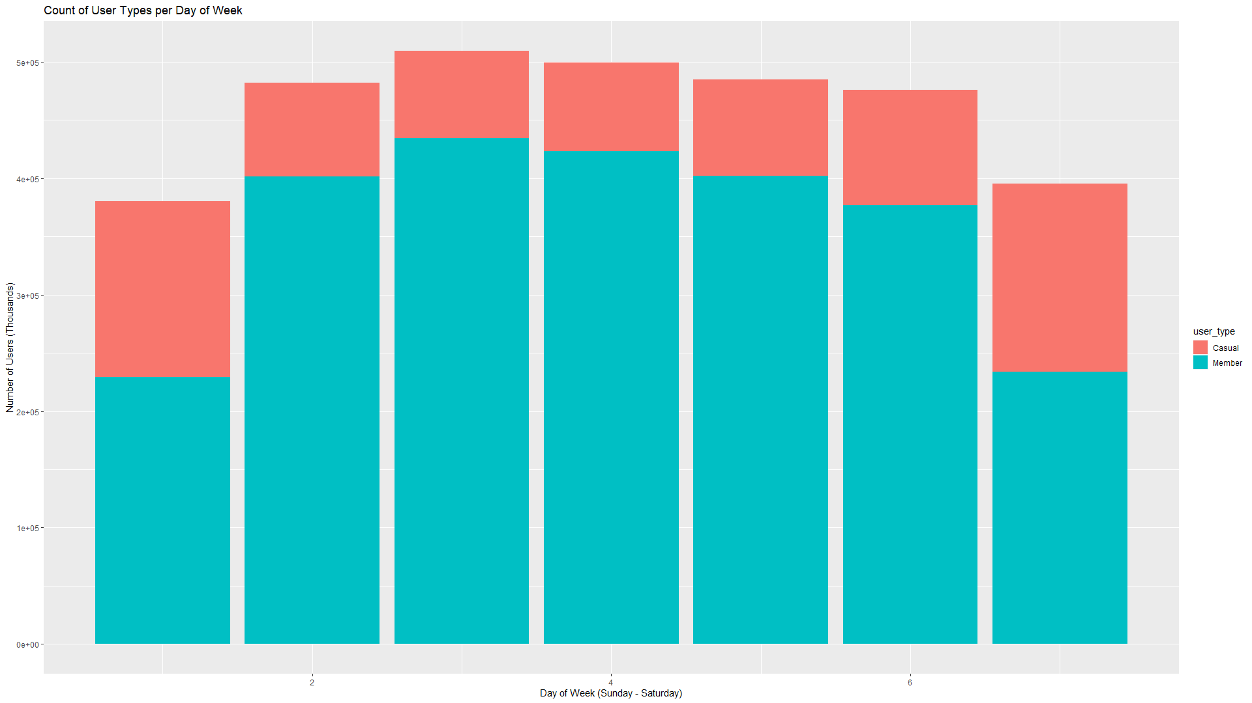
Share

Slide 8
Analyze
Why would casual riders buy annual memberships?

Slide 9
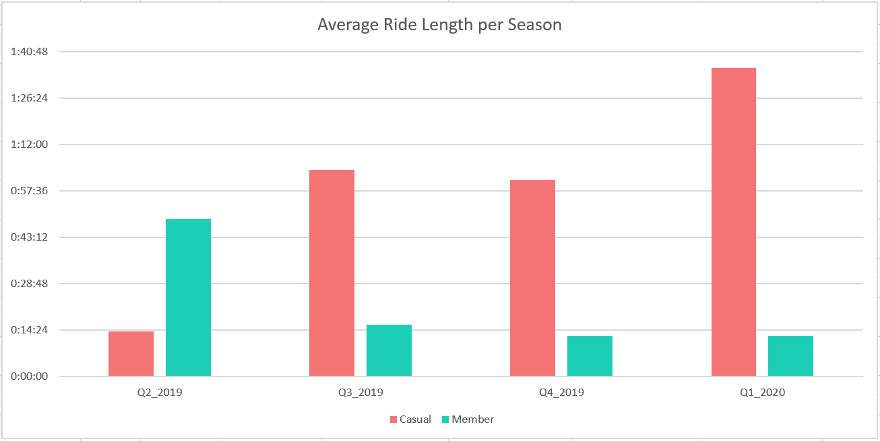
Share

Slide 10
Analyze
How can Cyclistic use digital media to influence casual riders to become members?

Slide 11
Share
Tuesday is the highest usage day of the week

Slide 12
Act
Target casual riders who predominantly use Cyclistic on weekends with a “weekend sign-up special” campaign
Target casual riders who have higher average ride-length times than members, and compare their casual rate per usage versus their membership rates per usage, which benefits both the prospective member and the company’s growth. Additionally, market the how the probability of bikes getting stolen or damaged decreases from casual riders to members, based on average ride length time.
Promote a social media campaign for a “Tuesday Promo” with discounted rates, free rides, or special gifts to members on Tuesdays since it is the highest usage day of the week throughout the year

Slide 13
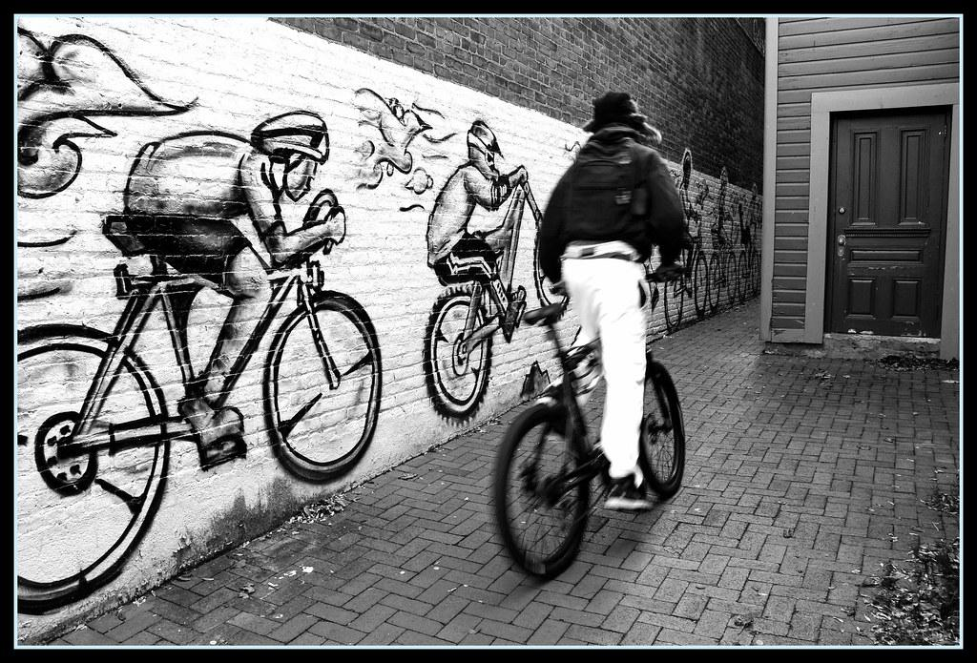
Thank you!

